Slide 1
Geography

Slide 2
Deep time, shifting continents

Slide 3
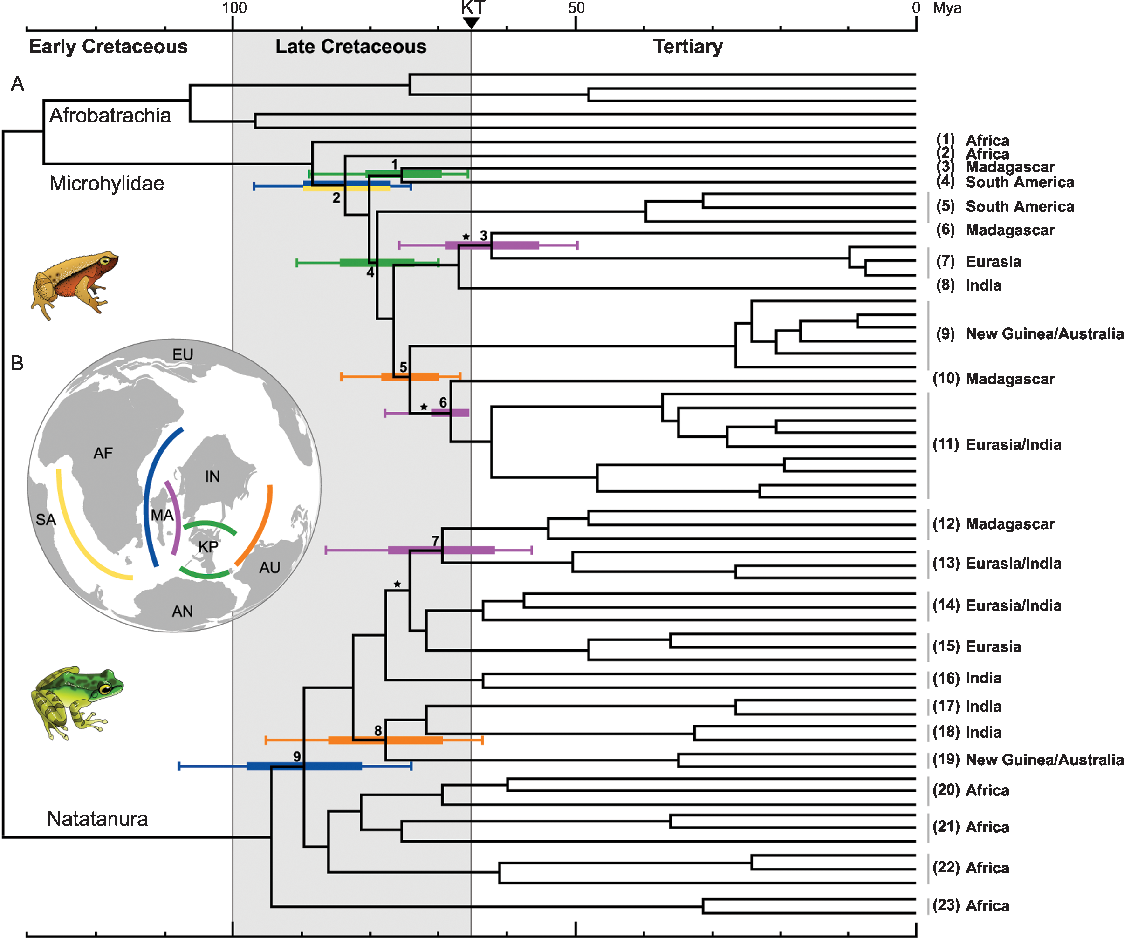

Slide 4
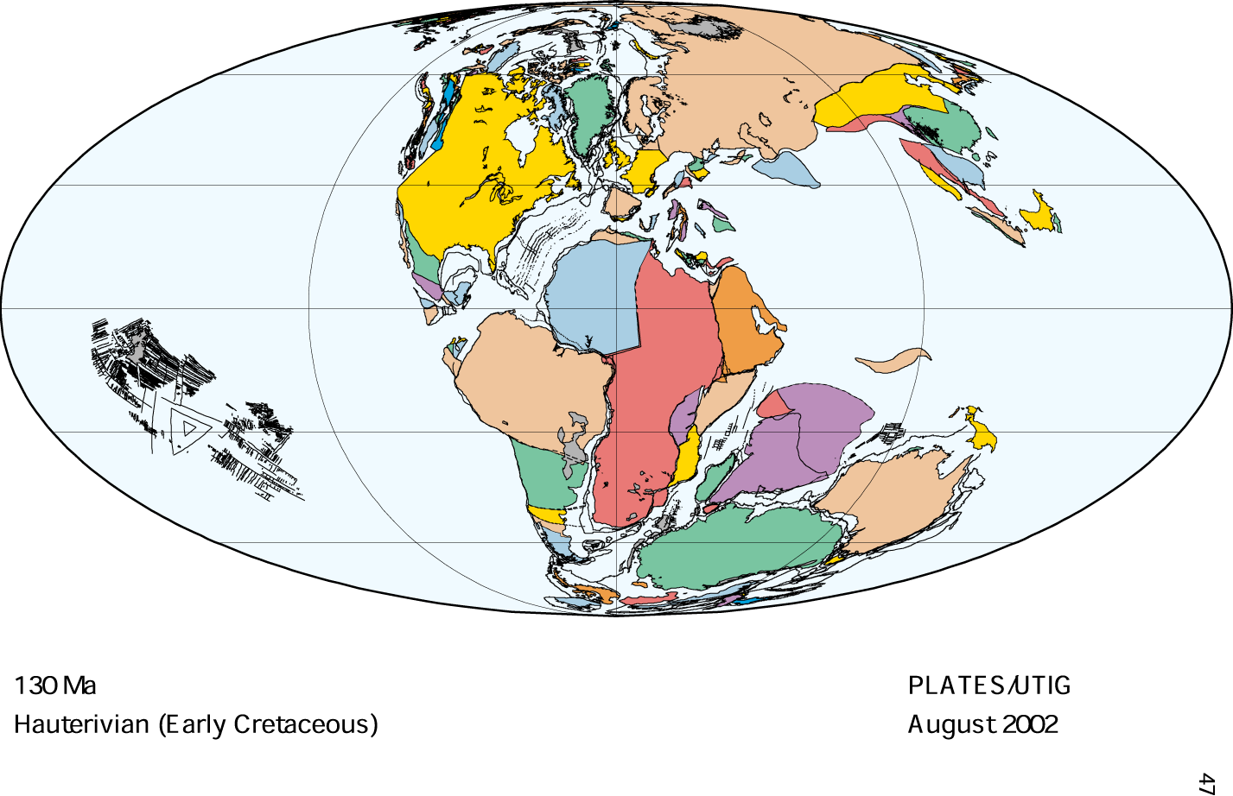

Slide 5
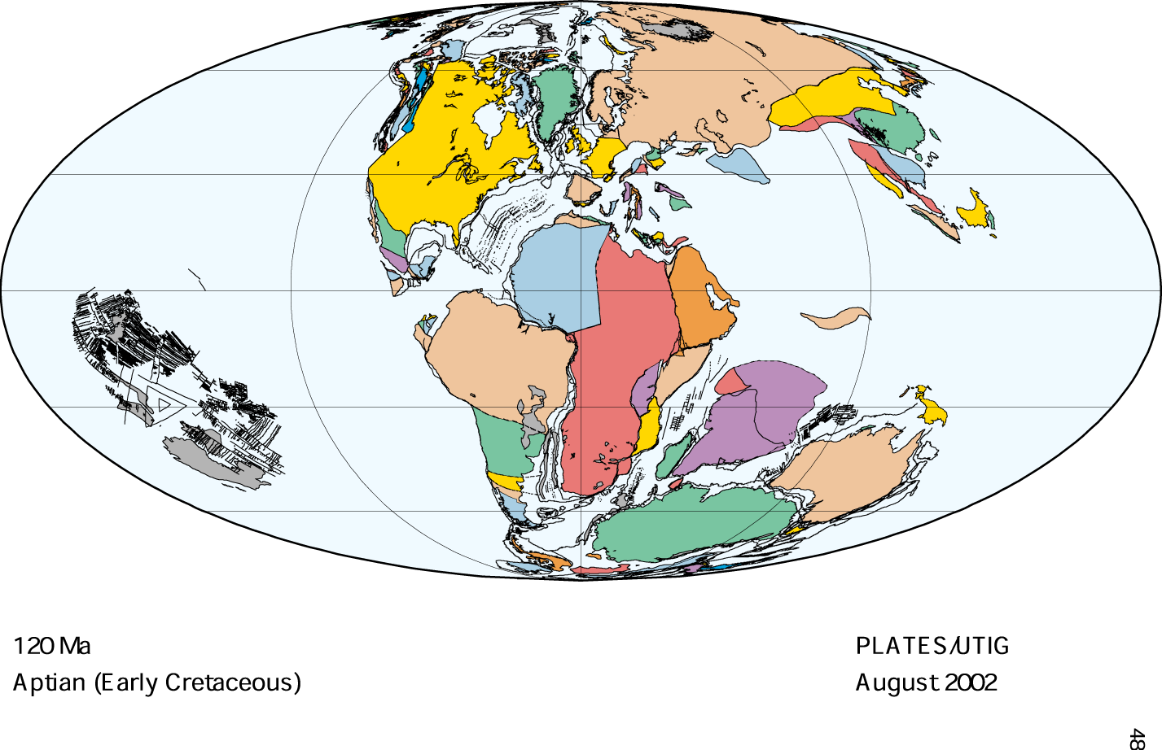

Slide 6
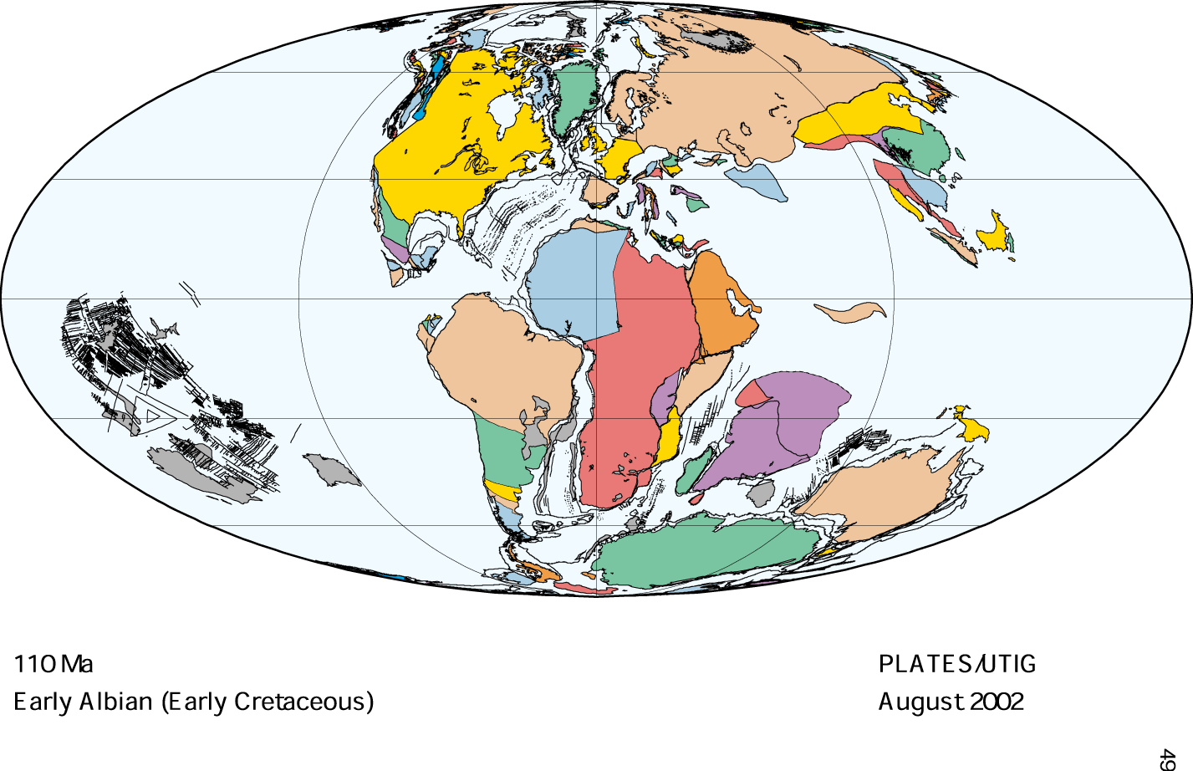

Slide 7
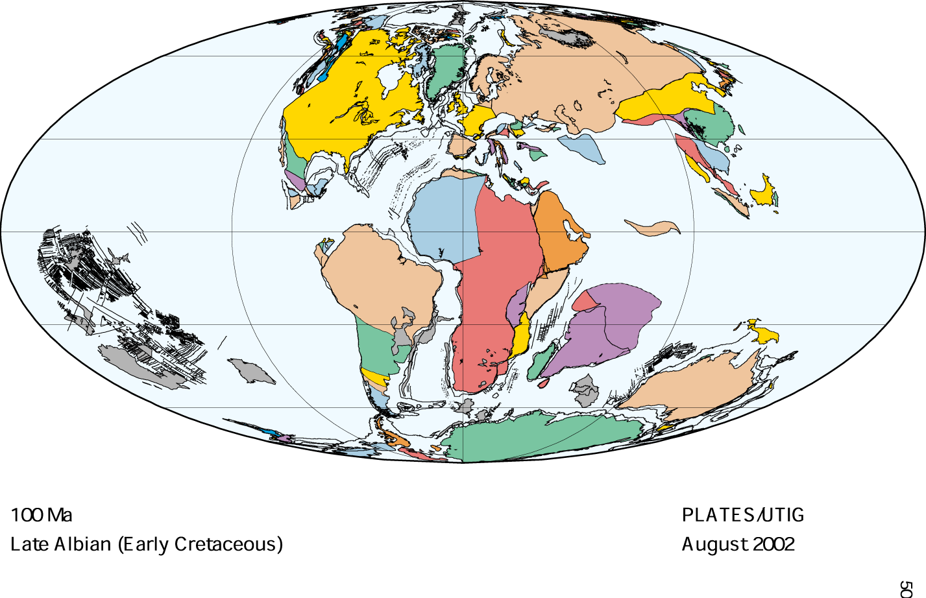

Slide 8
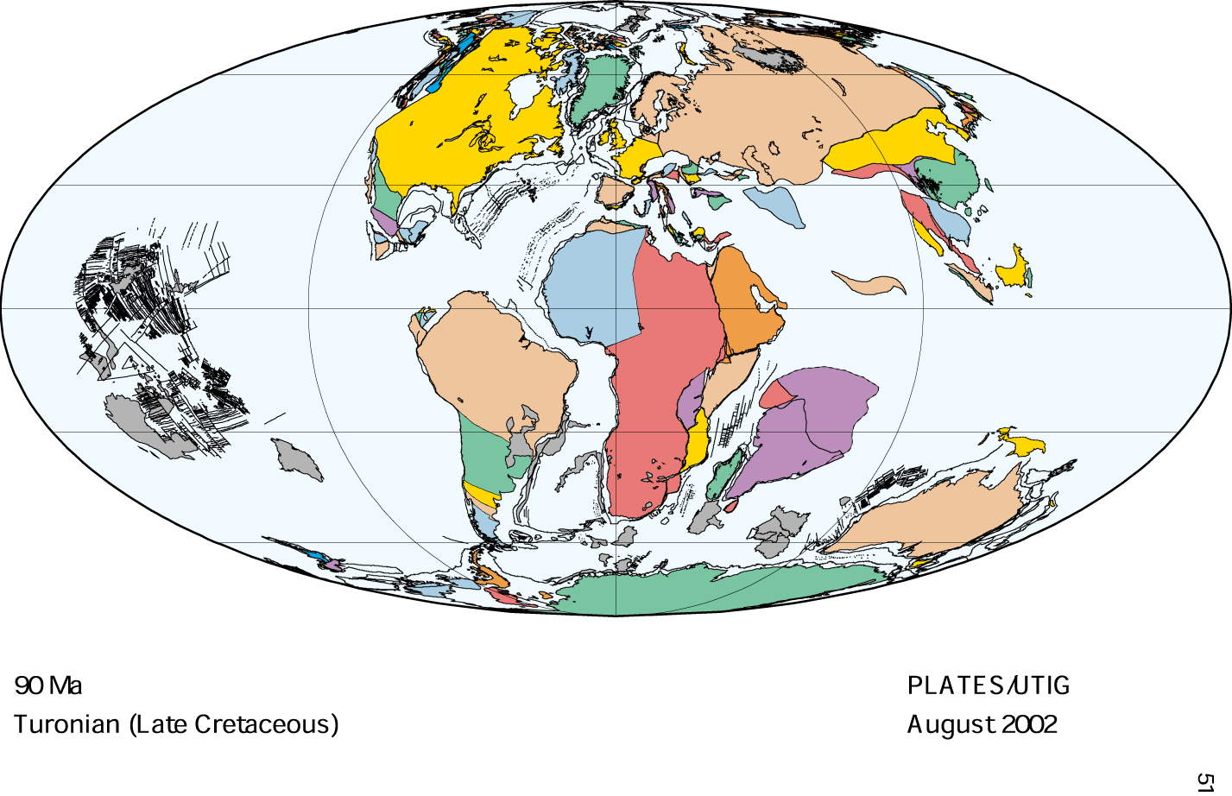

Slide 9
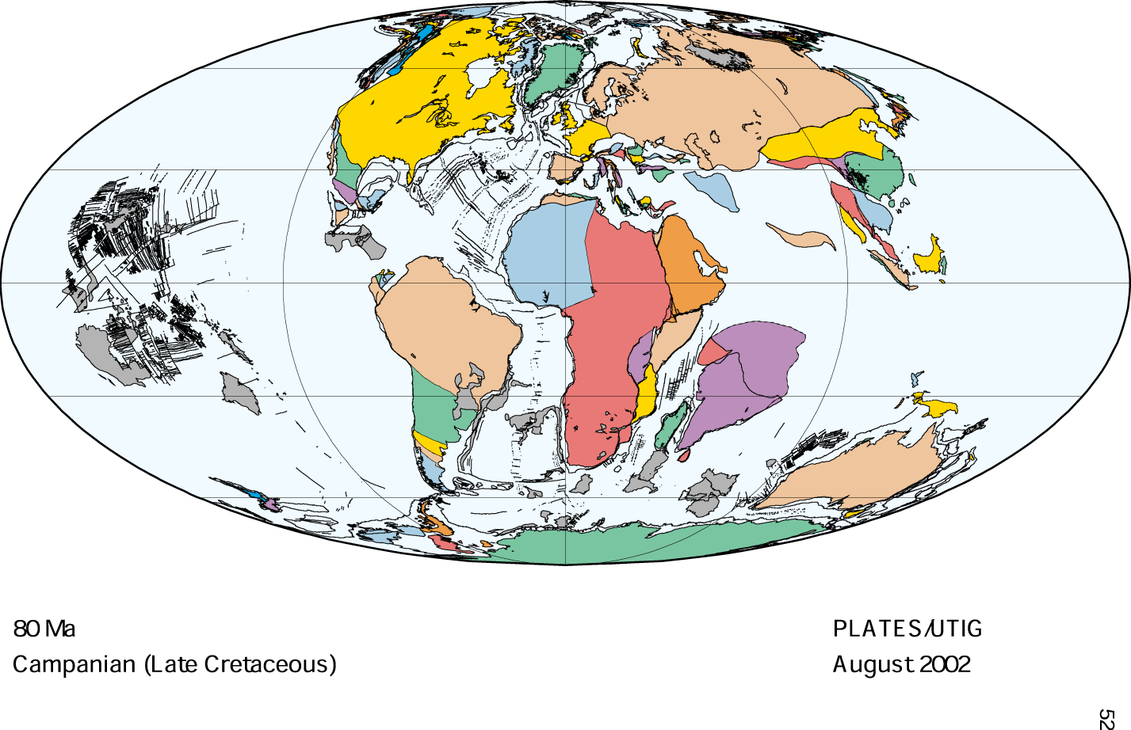

Slide 10
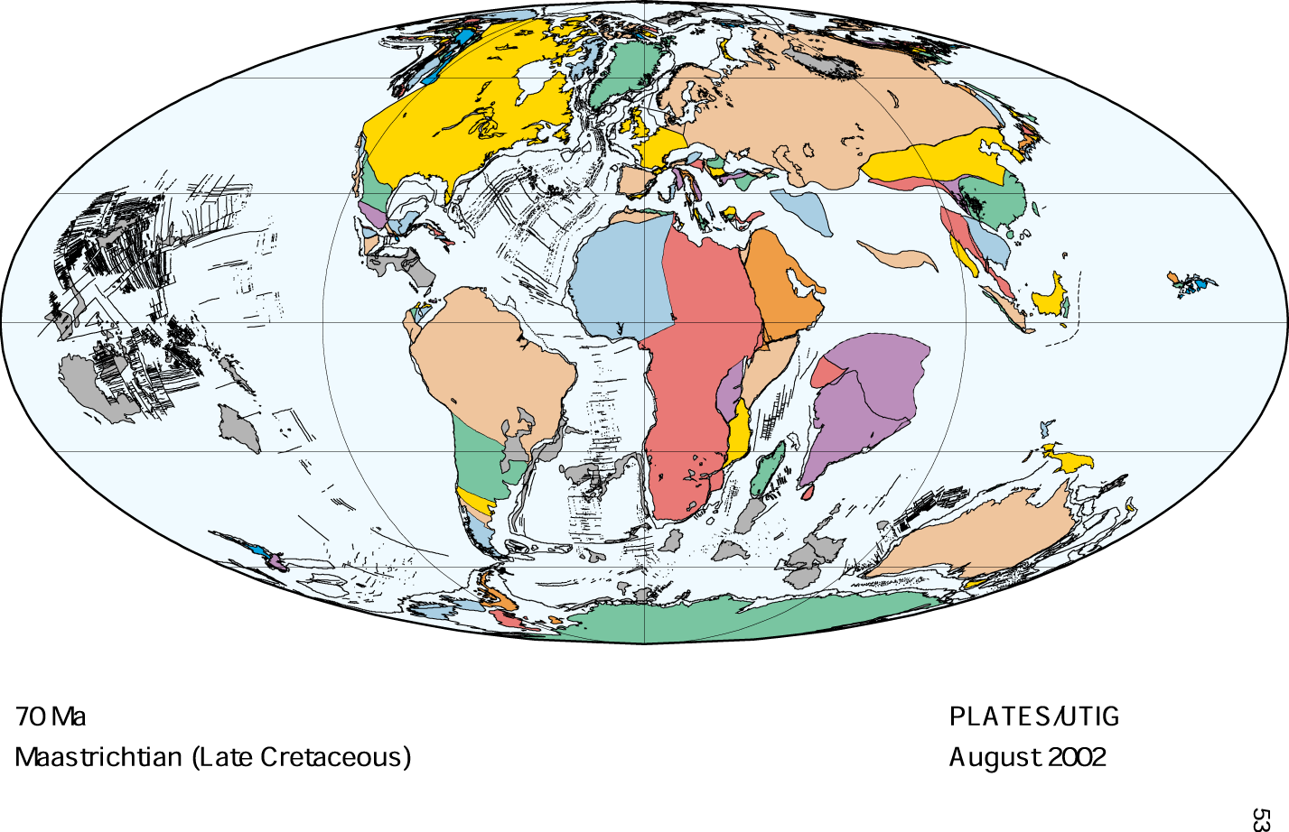

Slide 11
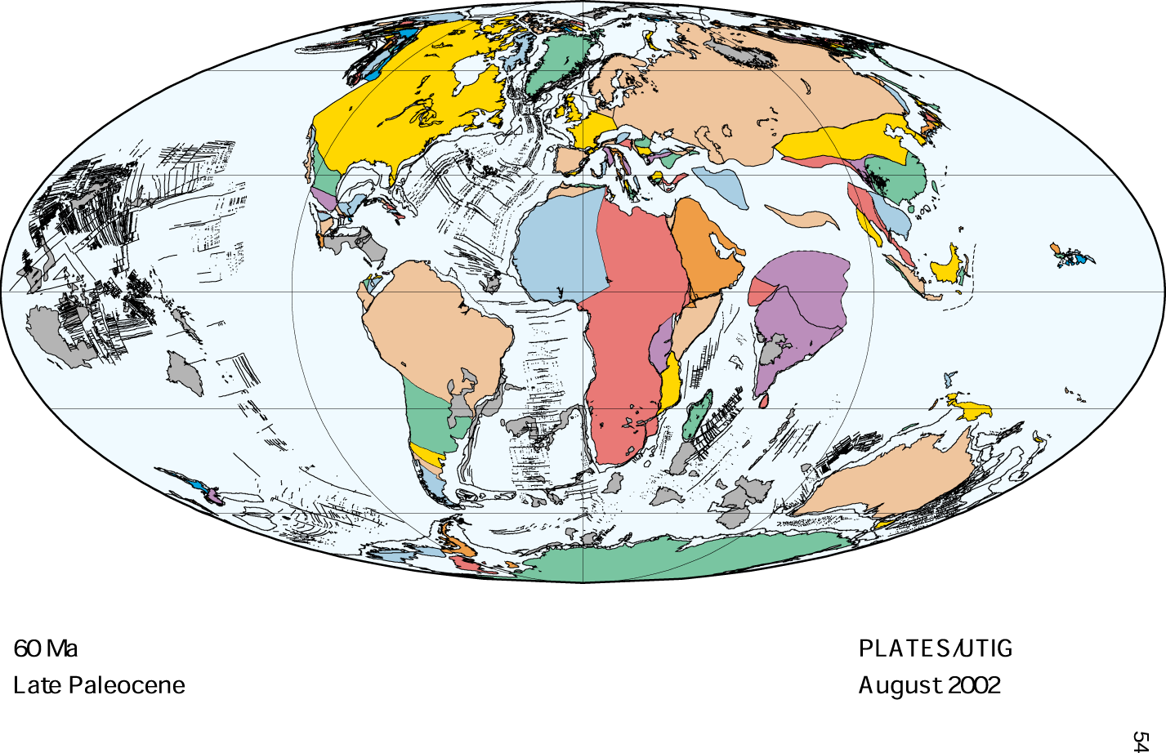

Slide 12
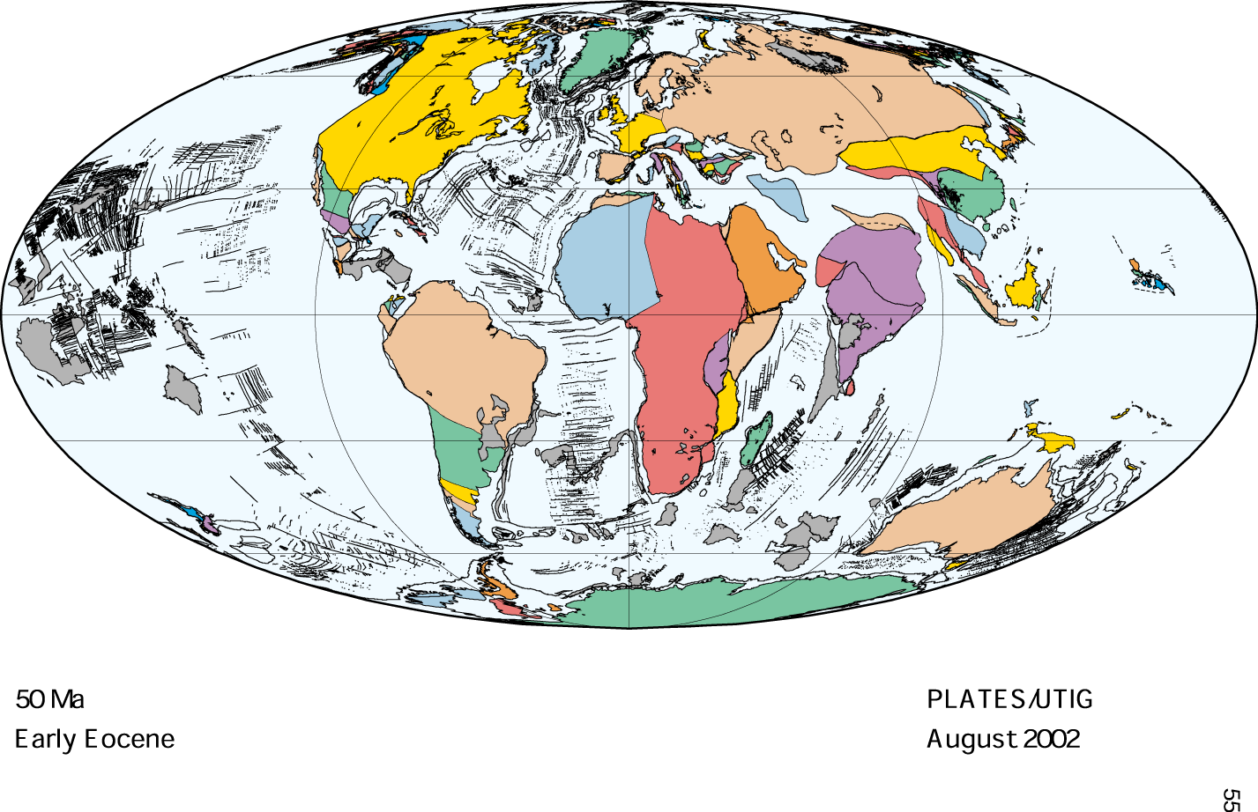

Slide 13
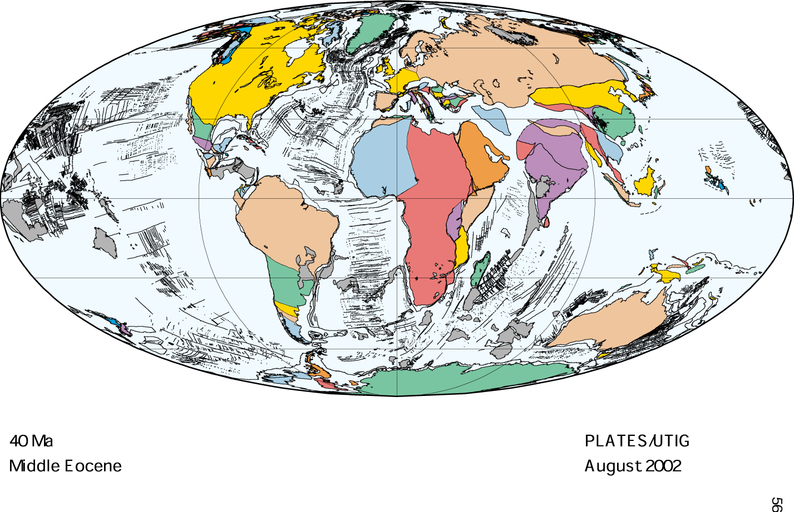

Slide 14
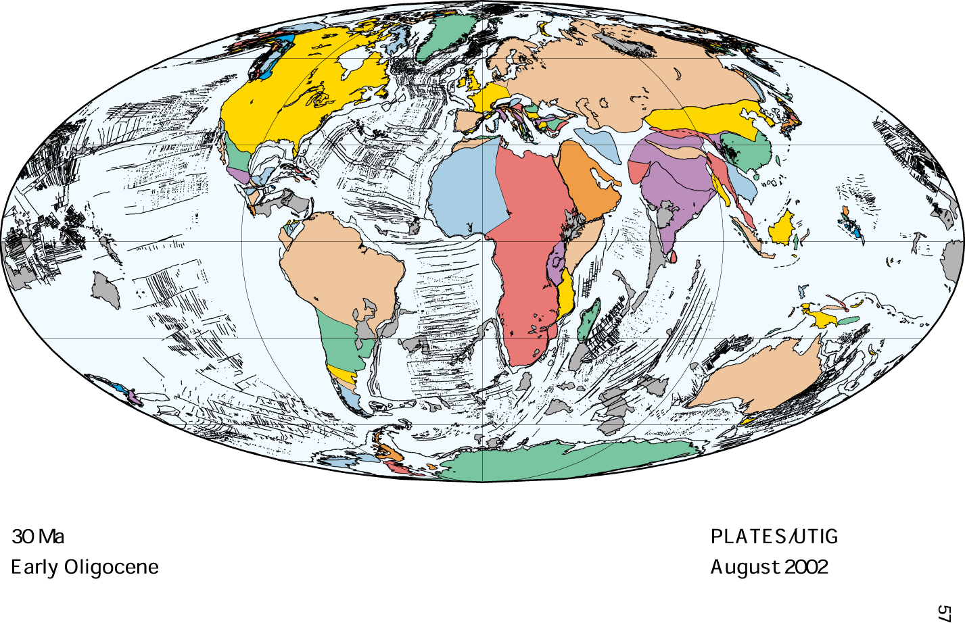

Slide 15
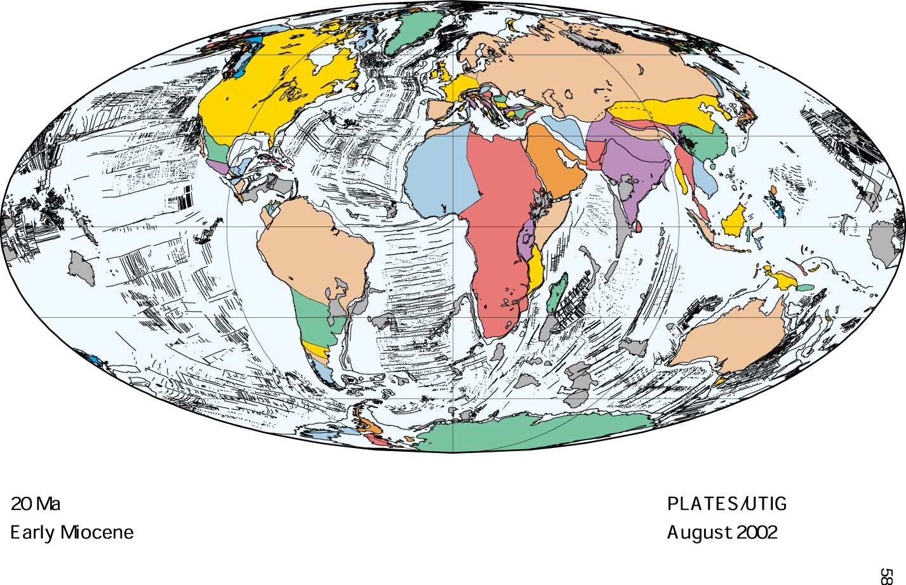

Slide 16
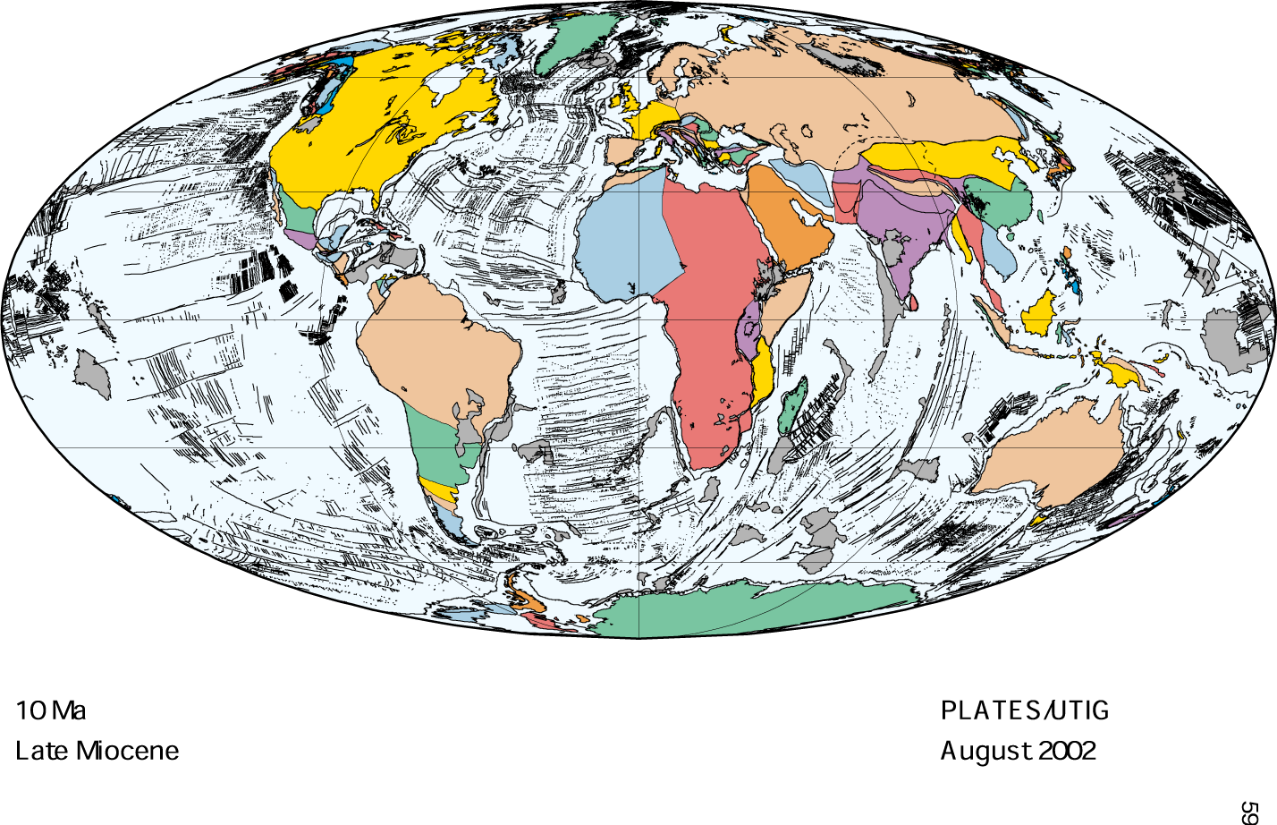

Slide 17
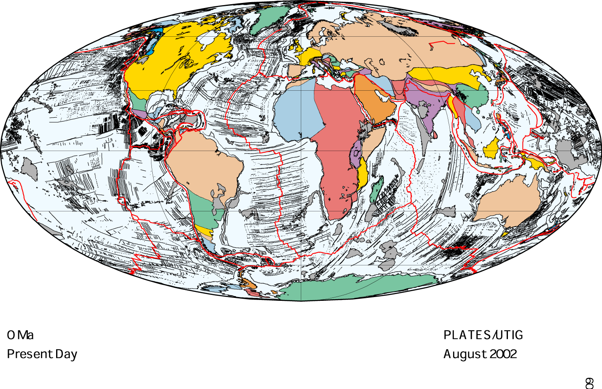

Slide 18
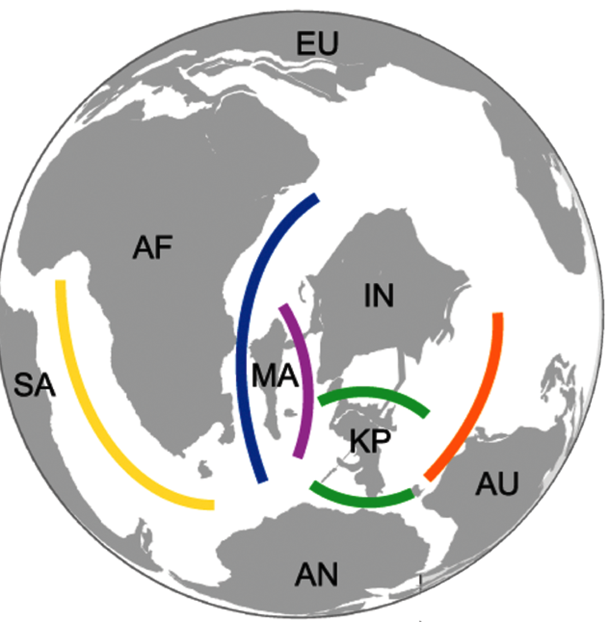
130
90
110
100
110

Slide 19
Geological area cladogram
Africa
130
South America
110
90
Madagascar
India
100
Australia
New Guinea

Slide 21
Recent time, shifting organisms

Slide 22

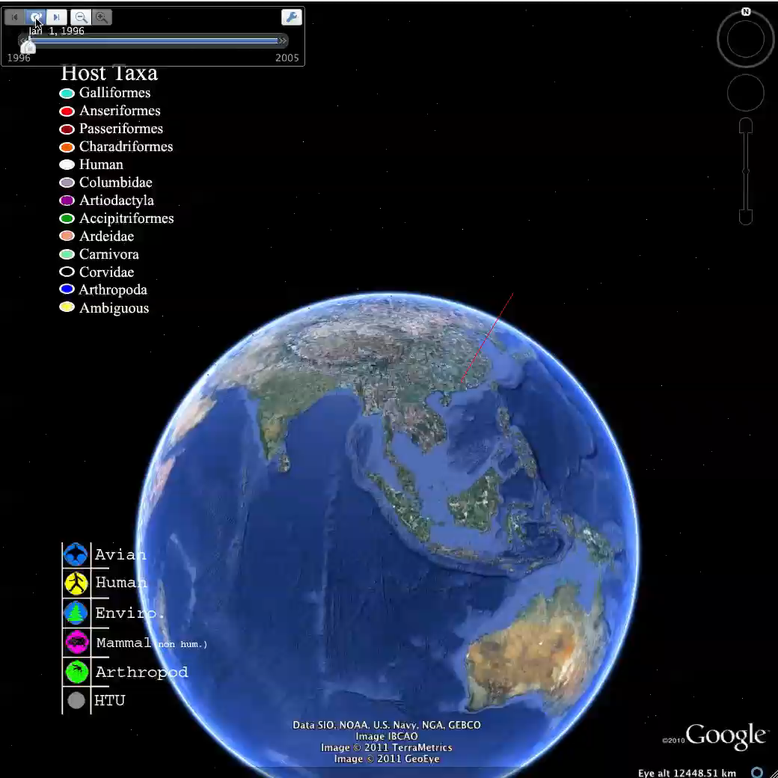
@andrewxhill

Slide 23
Sinking island, running to stay in the same place

Slide 24
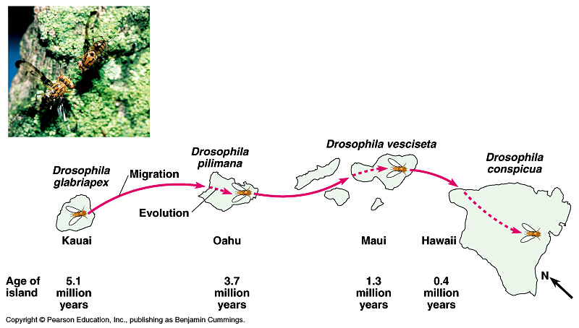
Figure 22.16 The evolution of fruit fly (Drosophila) species on the Hawaiian archipelago

Slide 25
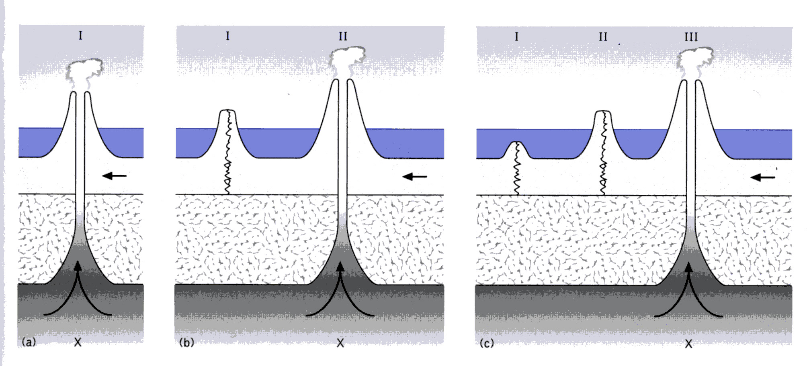
Hotspot

Slide 26
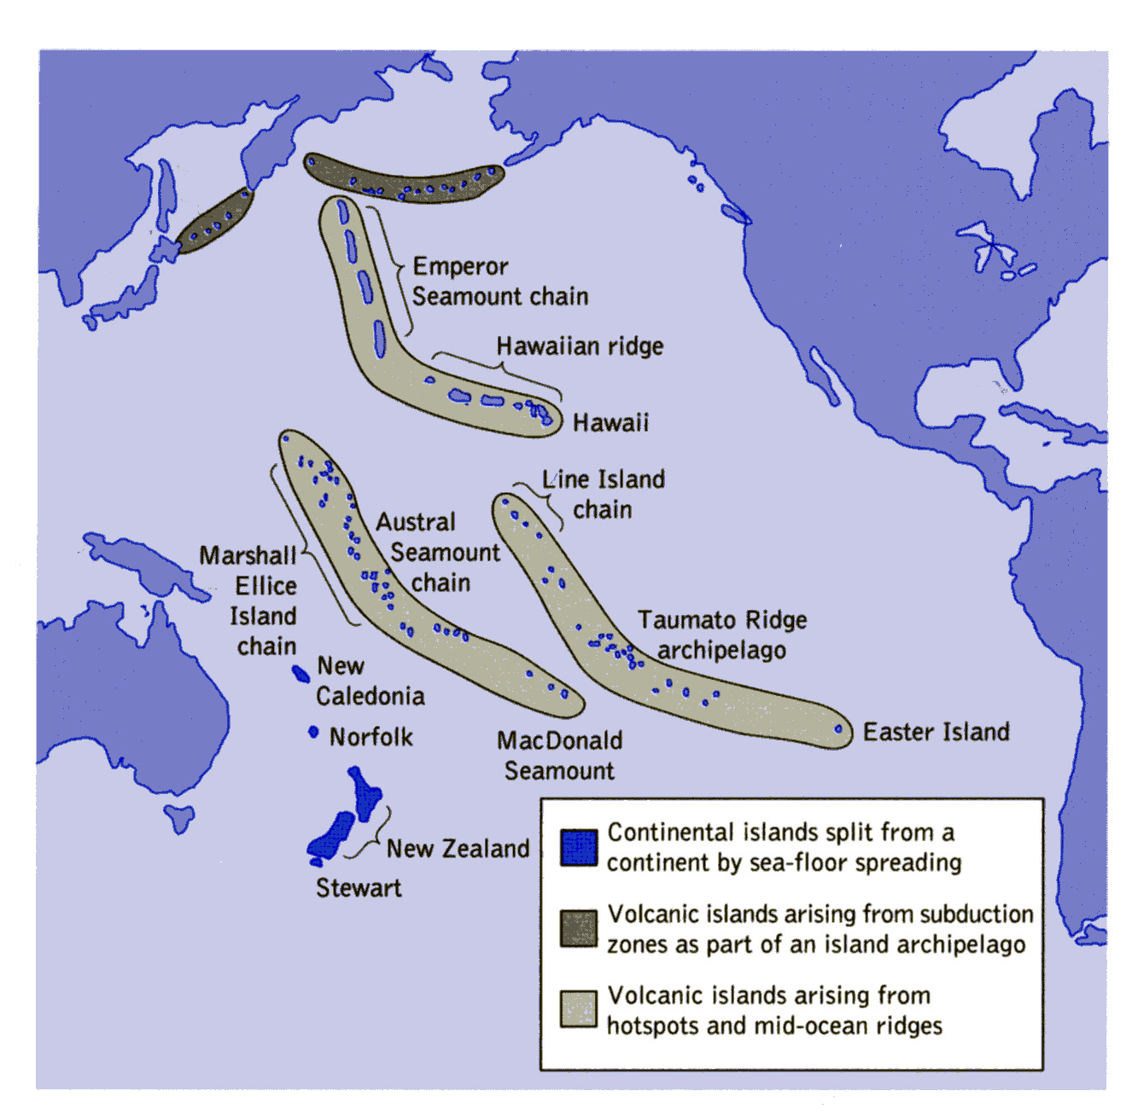

Slide 27
Properties of maps

Slide 28
Maps are predictable

Slide 29
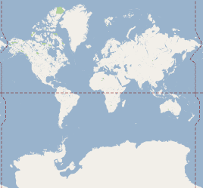

Slide 31
Navigation is predictable

Slide 32
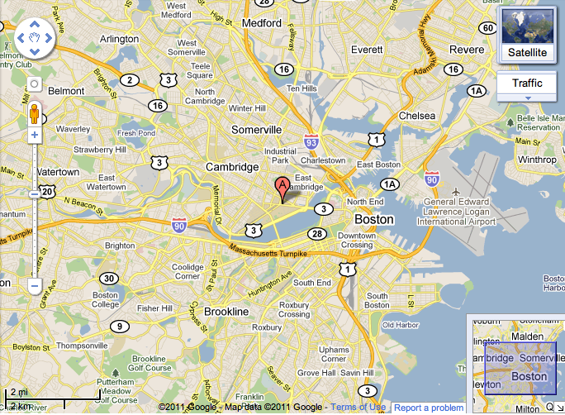

Slide 33
Every pixel counts

Slide 35
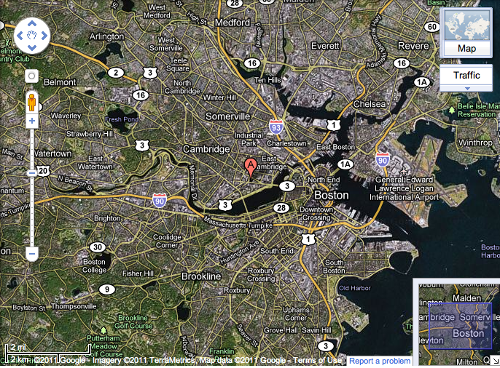

Slide 36
Ground truth

Slide 38
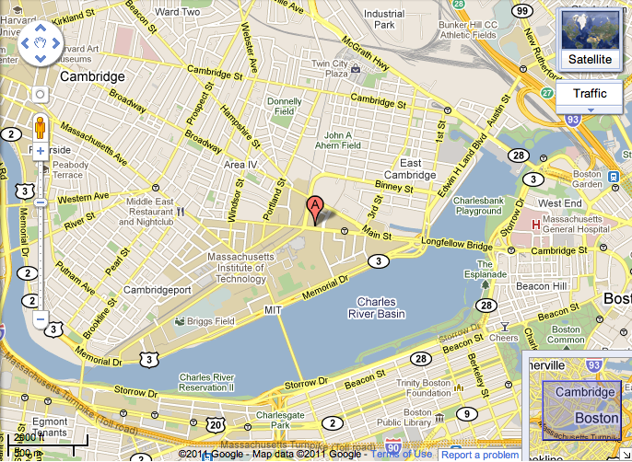

Slide 39
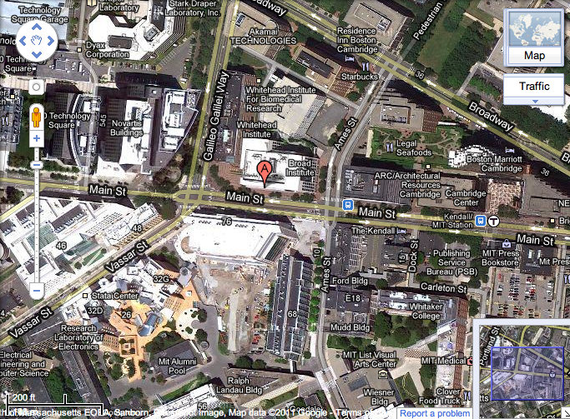

Slide 40
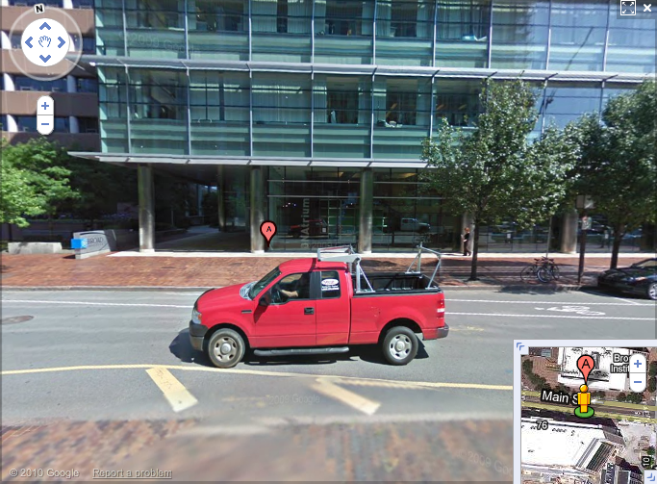

Slide 41
Relative and absolute navigation

Slide 42
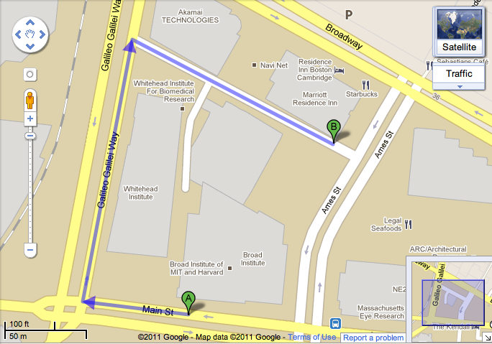

Slide 43

Latitude 42.363921 Longitude -71.087763

Slide 44
Sources of maps (other than Google)

Slide 45
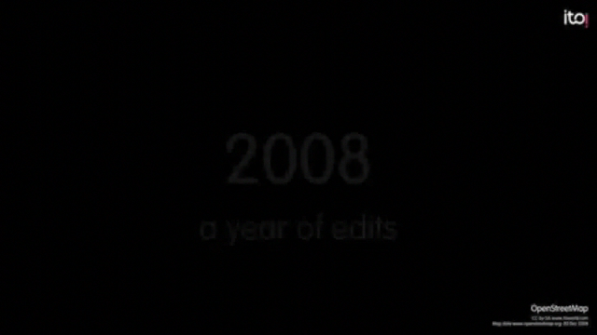
OpenStreetMap

Slide 46

http://www.gbif.org
See http://www.mendeley.com/groups/1068301/gbif-public-library/ for uses

Slide 47
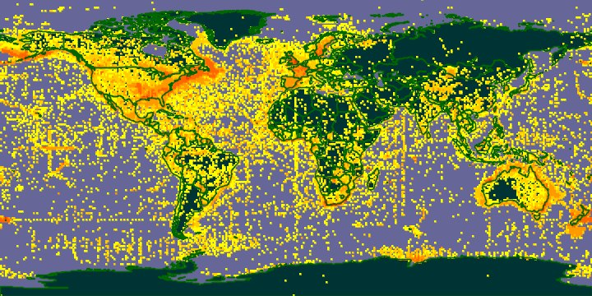

Slide 48
Lots of data, but some issues, such as sampling bias and errors

Slide 49

@andrewxhill

Slide 50
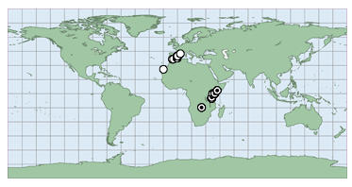
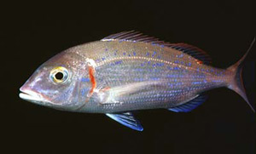
Transposed latitude and longitude

Slide 51
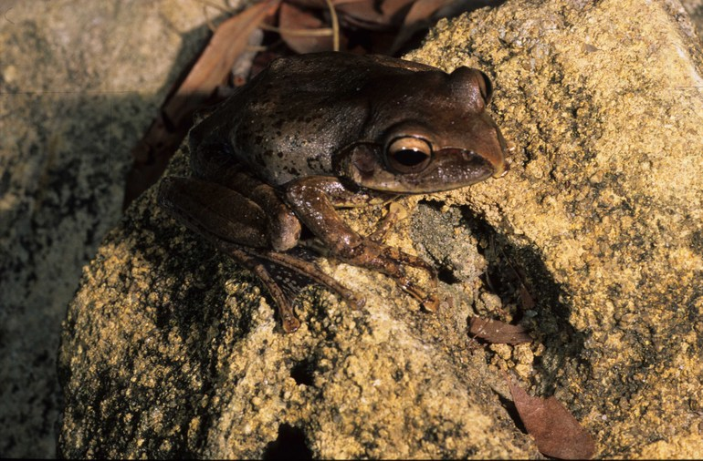
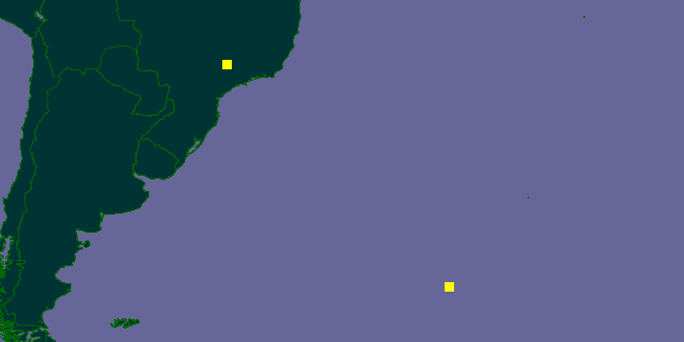
Boophis periegetes

Slide 52
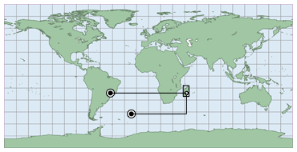
Boophis periegetes

Slide 53
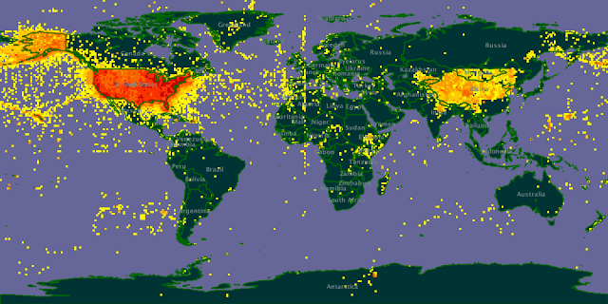
Specimens from “USA”

Slide 54
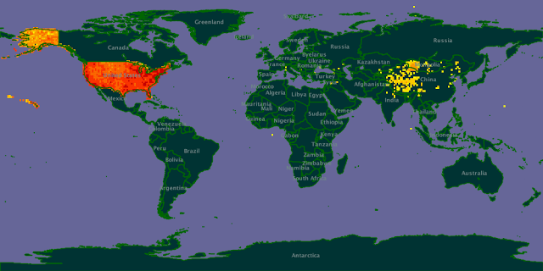

Slide 55
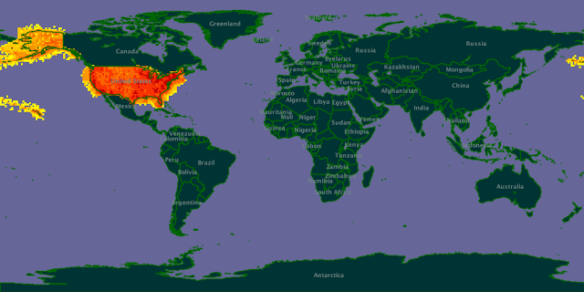

Slide 56
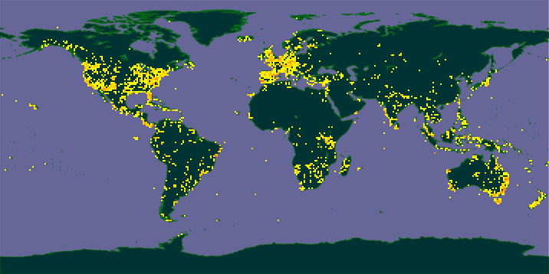
Flickr EOL group

Slide 57
Crowd sourcing
Where is the “crowd”?
It’s where the iPhones are…

Slide 58
Things to do with maps

Slide 59
Add time

Slide 60
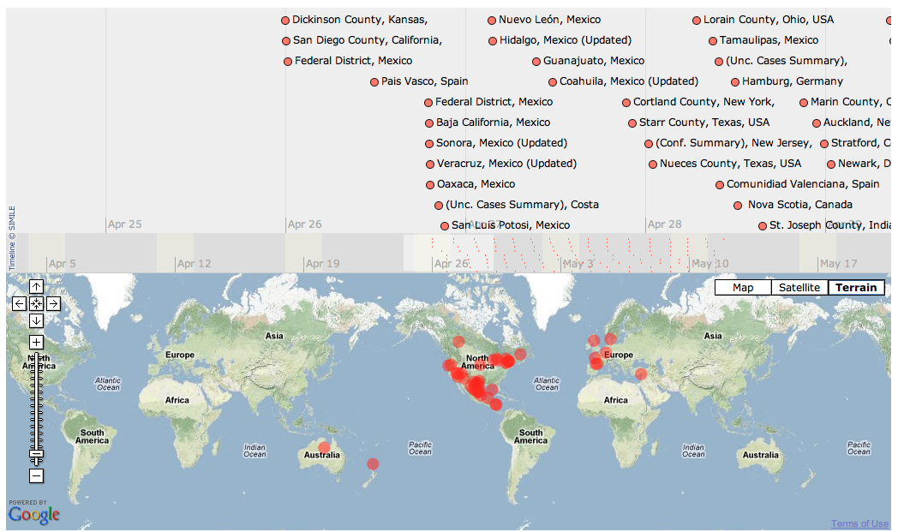
Timemaps

Slide 61
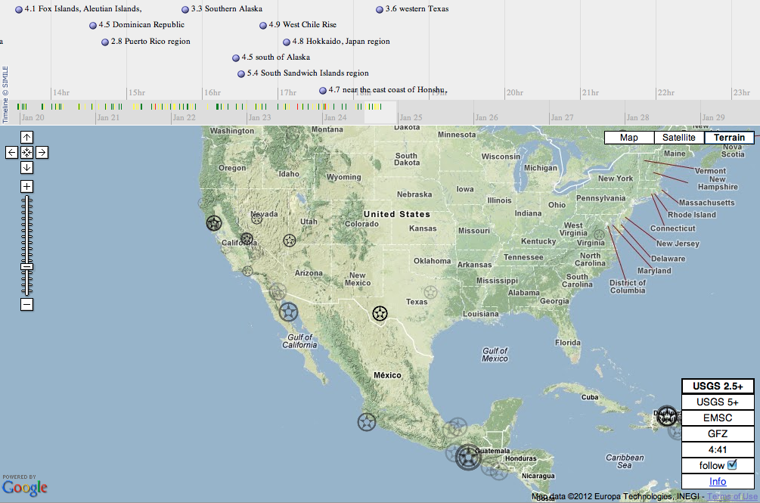
Notes:
http://www.oe-files.de/gmaps/eqmashup.html

Slide 62
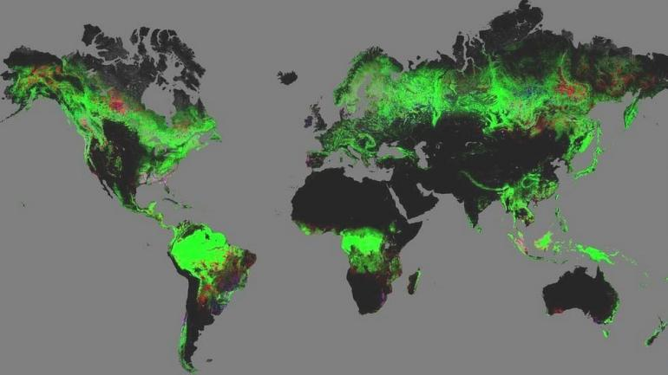
Global Forest Change

Slide 63
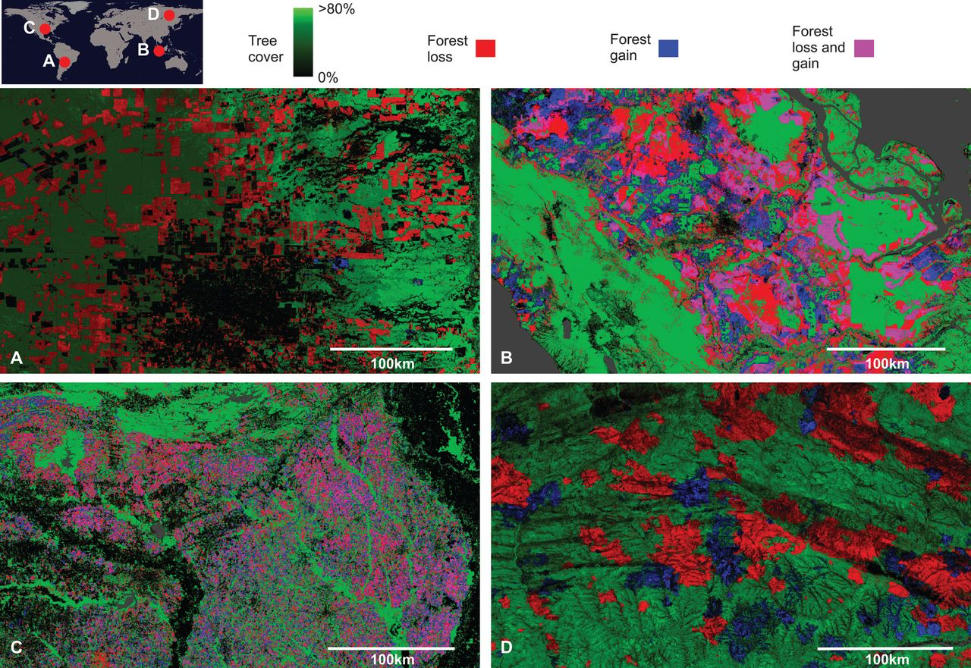

Slide 64
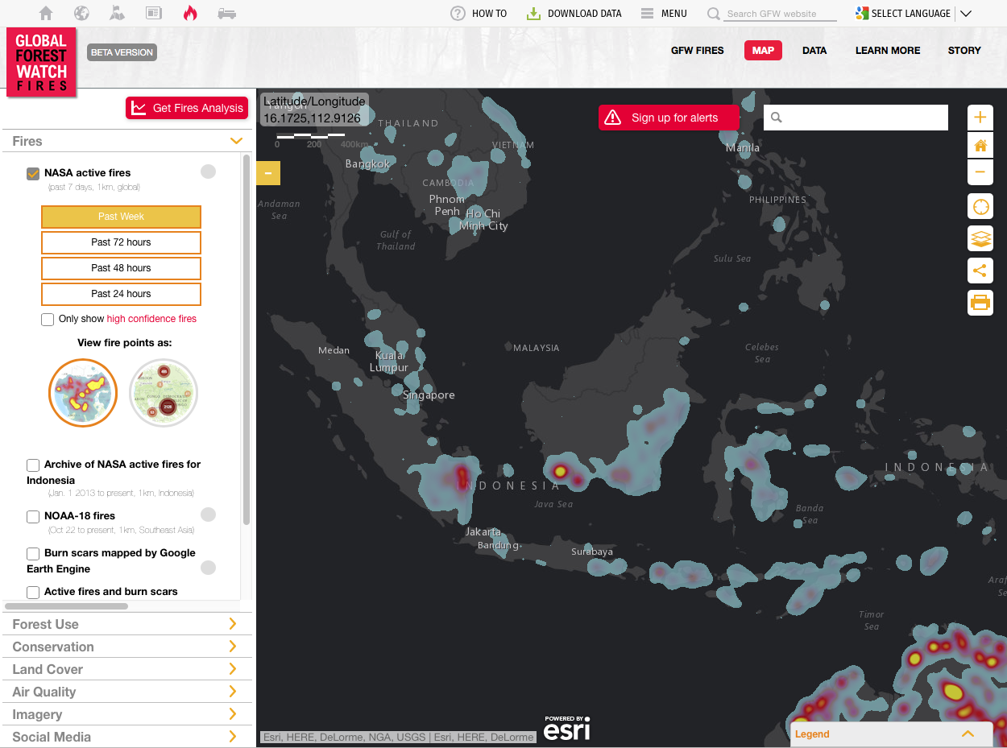

Slide 65
Knowing what we know

Slide 66


Slide 67
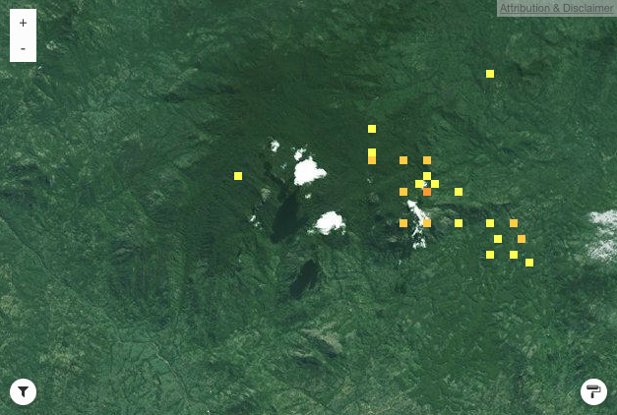
Mt Mabu on GBIF

Slide 68
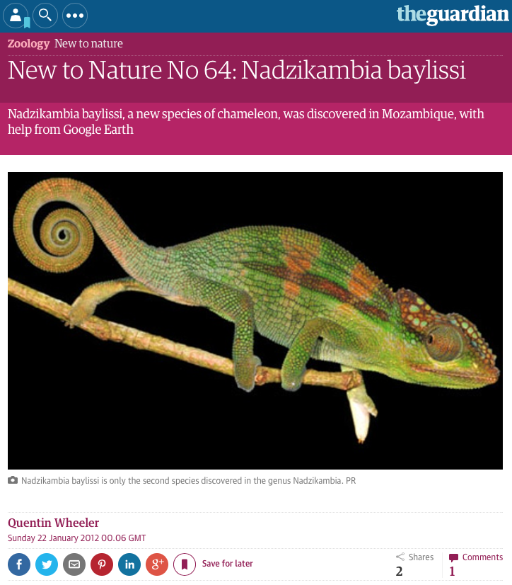

Slide 69
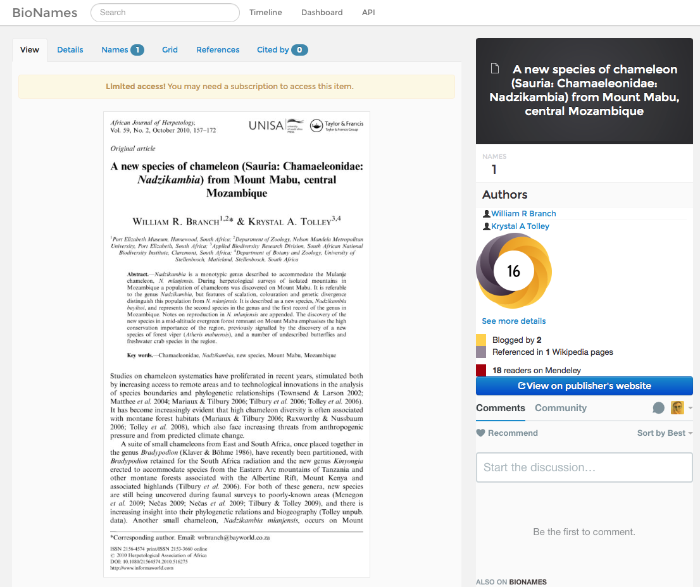
http://bionames.org
Notes:
http://bionames.org/references/702d63814e74063632a9d99b5ba72d15

Slide 70
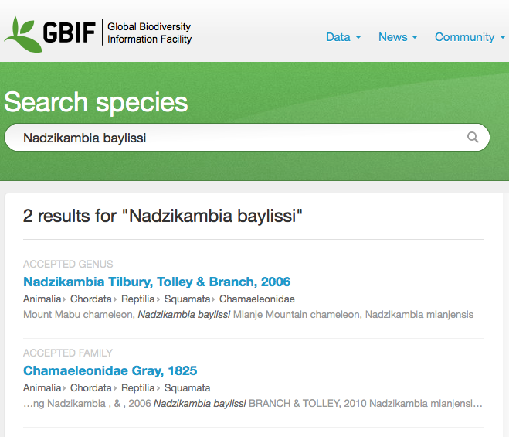

Slide 71
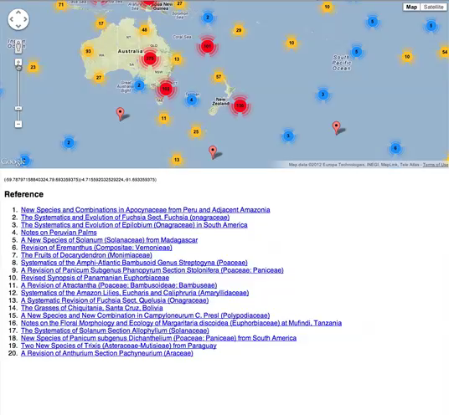
Bounding box http://biostor.org/maps

Slide 72
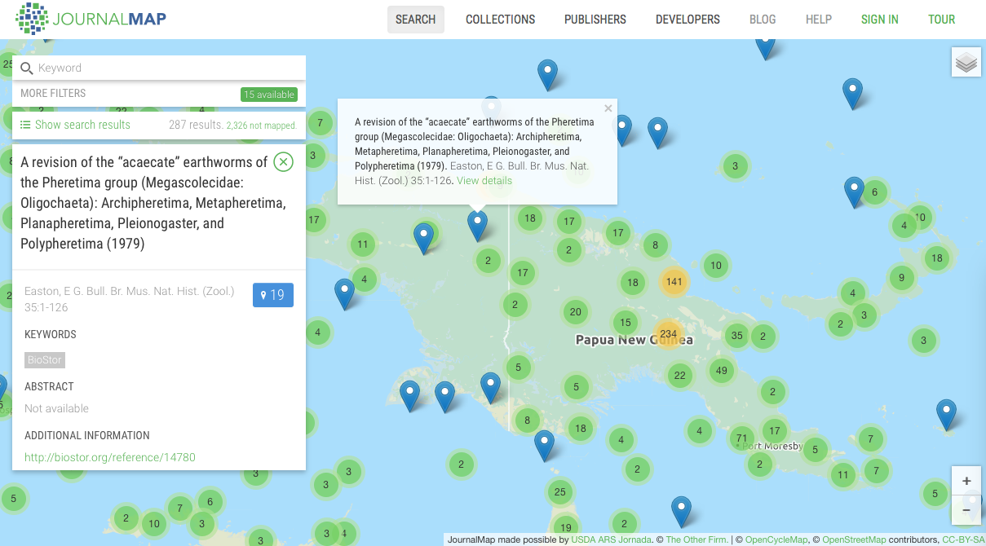
http://journalmap.org/

Slide 73
How to draw on maps

Slide 74
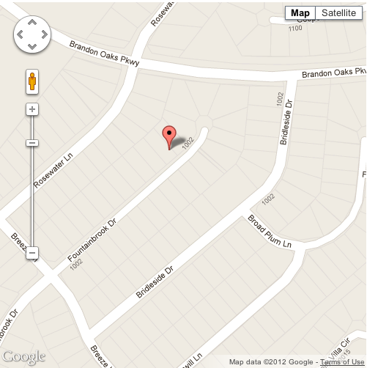
Plotting things on maps: points

Slide 75

Plotting things on maps: polygons

Slide 76

Plotting things on maps: points and lines

Slide 77


Slide 78


@DavKidd

Slide 79
Geophylogenies

Slide 80


Slide 81


Slide 82



Slide 84

BOLD DNA barcodes http://iphylo.org/~rpage/bold-map

Slide 85

http://iphylo.org/~rpage/geojson-phylogeny-demo/

Slide 86

Beyond points

Slide 87

Great Globe Project 128m diameter, 10.5 million tiles

Slide 88


Slide 89


Slide 90
The End

